Slide 1
Chapter 8 Solving Recurrence Relations
Section 1
Recurrence Relations

Slide 2
Outline
Recurrence Relations
Modeling with Recurrence Relations
The Tower of Hanoi
Catalan Numbers

Slide 3
Recurrence Relations
Remark.
  Many counting problems can be solved with recurrence relations
Example.
  The number of bacteria doubles every 2 hours. If a colony begins with 5 bacteria, how many will be present in n hours?
  Solution.
  Let a_{n} = 2a_{n-1} where n is a positive integer with a₀=5

Slide 4
Recurrence Relations
Definition. (递归关系)
  A recurrence relation for the sequence {a_{n}} is an equation that expresses a_{n} in terms of one or more of the previous terms of the sequence, i.e., a₀, a₁, …, a_{n-1}, for all integers n with n≥n₀ where n₀ is a nonnegative integer
  A sequence {a_{n}} is called a solution of a recurrence relation if its terms satisfy the recurrence relation

Slide 5
Recurrence Relations
Definition. (递归算法)
  A recursive algorithm provides the solution of a problem of size n in terms of the solutions of one or more instances of the same problem of smaller size
  Consequently, when we analyze the complexity of a recursive algorithm, we obtain a recurrence relation that expresses the number of operations required to solve a problem of size n in terms of the number of operations required to solve the problem for one or more instance of smaller size
  Recursive definitions (递归定义) can be used to solve counting problems. When they are used in this way, the rule for finding terms from those that precede them is called a recurrence relation

Slide 6
Recurrence Relations
Example.
  Let {a_{n}} be a sequence that satisfies the recurrence relation a_{n} = a_{n-1}- a_{n-2} for n = 2, 3, 4, … and suppose that a₀ = 3 and a₁ = 5, what are a₂ and a₃?
  Solution.
  Using the recurrence relation, a₂ = a₁-a₀ = 5-3 = 2 and a₃ = a₂-a₁ = 2-5 = -3

Slide 7
Recurrence Relations
Example.
  Determine whether the sequence {a_{n}}, where a_{n}=3n for every nonnegative integer n, is a solution of the recurrence relation
a_{n} = 2a_{n-1}- a_{n-2} for n = 2, 3, 4, …
  Solution.
  Suppose a_{n} = 3n for every nonnegative integer n. Then for n ≥ 2, we have
  2a_{n-1}-a_{n-2} = 2(3(n-1))-3(n-2) = 3n = a_{n}.
  Thus, {a_{n}} where a_{n} = 3n is a solution for the recurrence relation

Slide 8
Recurrence Relations
Example.
  Consider the above recurrence relation
  a_{n} = 2a_{n-1}- a_{n-2} for n = 2, 3, 4, …
  whether a_{n} = 2^{n} is a solution of this recurrence relation? What about a_{n} = 5?
  Solution.
  Assume that a_{n} = 2^{n} is; then:
a₀ = 2⁰ = 1; a₁ = 2¹ = 2; a₂ = 2² = 4
  But our recurrence relation says that
  a₂ = 2a₁- a₀ = 4 - 1 = 3
  It is a contradiction. So, a_{n} = 2^{n} is not a solution of the recurrence relation
  It is easy to show that a_{n} = 5 is a solution of the recurrence relation: 2a_{n-1} – a_{n-2} =2⋅5 – 5 = 5 = a_{n}

Slide 9
Modeling with Recurrence Relations
Remark.
  We can use recurrence relations to modeling a wide variety of problems
Example.
  Compound interest: Suppose that a person deposits $10,000 in a savings account yielding 11% per year with interest compounded (复利) annually. How much will it be in the account after 30 years?
  Let a_{n} denote the amount in the account after n years. The amount after n years equals the amount in the amount after n-1 years plus interest for the n-th year, we see the sequence {a_{n}} has the recurrence relation
  a_{n} = a_{n-1}+0.11a_{n-1} = (1.11) a_{n-1}

Slide 10
Modeling with Recurrence Relations
  The initial condition a₀=10,000, thus
    a₁ = (1.11) a₀
    a₂ = (1.11) a₁ = (1.11)² a₀
    a₃ = (1.11) a₂ = (1.11)³ a₀
    …
    a_{n} = (1.11) a_{n-1} = (1.11)^{n} a₀
  We can use mathematical induction to establish its validity
  When n = 30, a₃₀ = (1.11)³⁰10,000 = 228,922.97

Slide 11
Modeling with Recurrence Relations
Example. (Rabbits and the Fibonacci Sequence)
  A young pair of rabbits (one of each sex) is placed on an island.
  A pair does not breed until they are 2 months old.
  After they are 2 months old, each pair produces another pair each month.
  Find a recurrence relation for the number of pairs of rabbits on the island after n months, assuming that no rabbits ever die.

Slide 12
Modeling with Recurrence Relations
  Solution.
  Let f_{n} = number of pairs of rabbits on the island at the end of n months.
  We know that f₁ = 1 and f₂ = 1 (because the rabbits don’t breed until they are two months old).
  At the end of the third month, the first pair has 2 baby bunnies. So f₃ = 2.
  At the end of the fourth month, the first pair has 2 more baby bunnies. The second pair is still too young to have bunnies, so f₄ = 3.
  At the end of the fifth month, the first pair has 2 more baby bunnies, and the second pair has its first 2 baby bunnies. The third pair is still too young to have bunnies, so f₅ = 5.

Slide 13
Modeling with Recurrence Relations
  Solution. (continued)
  At the end of the fifth month, the first pair has 2 more baby bunnies, and the second pair has its first 2 baby bunnies. The third pair is still too young to have bunnies, so f₅ = 5.
Month | Reproducing Pairs | Young Pairs | Total Pairs
1 | 0 | 1 | 1
2 | 0 | 1 | 1
3 | 1 | 1 | 2
4 | 1 | 2 | 3
5 | 2 | 3 | 5
6 | 3 | 5 | 8

Slide 14
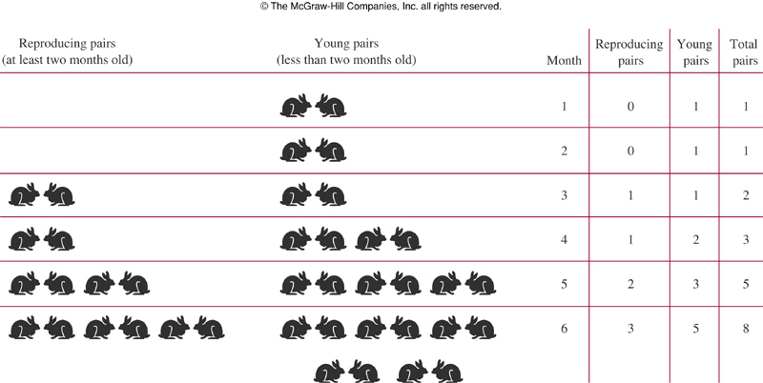
Modeling with Recurrence Relations
  Solution. (continued)

Slide 15
Modeling with Recurrence Relations
  Solution. (continued)
  At the end of the n-th month, the number of pairs = the number of pairs the previous month (which is f_{n-1}) + the number of newborn pairs (which is f_{n-2}, because any pair 2 months old or older will produce a new pair).
  So our recurrence is:
    f₁ = 1
    f₂ = 1
    f_{n} = f_{n-1} + f_{n-2}, for n ≥ 3.
  This is the Fibonacci Sequence

Slide 16
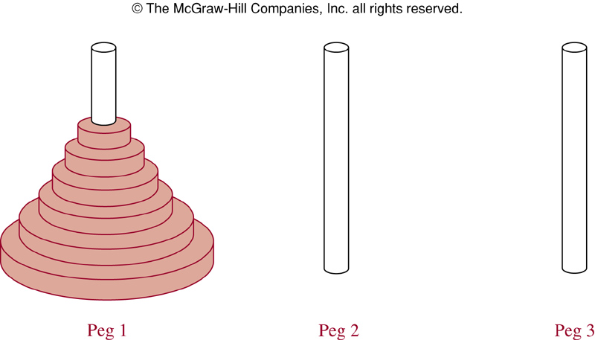
The Tower of Hanoi
The Tower of Hanoi
  Only one disk can be moved at a time
  No larger disk may be placed on top of a smaller one
  Have all the disks on the Peg 2 in order of size, with the largest on the bottom

Slide 17
The Tower of Hanoi
The Tower of Hanoi
  An old legend states that there is a monastery in Hanoi containing three golden pegs with 64 gold disks.
  Originally, all 64 disks were on one peg, arranged so that the largest disk was on the bottom and so on up to the top disk, which was the smallest.
  The monks’ task is to move all of the disks from one peg to another.
  When they finish, the world will end!

Slide 18
The Tower of Hanoi
  Solution.
  We need to find a recurrence relation to find the number of moves needed to solve the Tower of Hanoi problem with n disks.
  Consider the following smaller version of the problem:
Peg 1
Peg 2
Peg 3

Slide 19
The Tower of Hanoi
  Solution. (continued)
  It takes 1 move to transfer all 1 of the disks to peg 3
Peg 1
Peg 2
Peg 3

Slide 20
The Tower of Hanoi
  Solution. (continued)
  Now consider the following slightly larger version of the problem. How many moves does it take to transfer all 2 of the disks to peg 3?
Peg 1
Peg 2
Peg 3

Slide 21
The Tower of Hanoi
  Solution. (continued)
  Use H_{n} to denote the number of all the moves needed to solve the Tower of Hanoi problem with n disks
    First we have to transfer the stack above the bottom disk (by legally stacking the disks above it somewhere else), and it will take H_{n-1} moves
    Then we move the bottom disk. It takes 1 move
    Finally we rebuild the stack on top of the bottom disk, and it will also take H_{n-1} moves
  Now We get:
  H_{n} = 2H_{n-1}+1 or
  H_{n} = 2^{n} -1

Slide 22
The Tower of Hanoi
  Solution. (continued)
Peg 1
Peg 2
Peg 3

Slide 23
The Tower of Hanoi
  Solution. (continued)
  So it will take the monks 2⁶⁴-1 moves to solve the Tower of Hanoi puzzle. That’s a BIG number; there are (very roughly) 10⁶⁴ atoms in the Milky Way galaxy. So don’t worry about the monks finishing any time soon ….

Slide 24
Catalan Numbers
Example.
  在 n×n 的网格中，只允许向右或向上走，从左下角到右上角共有多少种不同的走法？如图为 4×4 网格中的一种走法。
E
S

Slide 25
Catalan Numbers
  Solution.
  每一种走法对应于一个长度为 2n 的字符串，该字符串由 n 个 R 和 n 个U字母构成，分别对应于向右和向上的动作。下图的走法对应于字符串 RRUURURU，可看成是从 2n个位置中选择 n 个位置放上R，其余位置填上 U 得到。故共有 C(2n, n) 种不同的走法。
E
U
R
U
R
U
U
S
R
R

Slide 26
Catalan Numbers
Example.
  在 n×n 的网格中，只允许向右或向上走，从左下角走向右上角，只能经过但不能超越从左下角到右上角的对角线（即路线只能在对角线的右下方）。共有多少种不同的走法？下图为一种犯规的走法。
E
S

Slide 27
Catalan Numbers
  Solution.
  由上例，从左下角走向右上角，共有 C(2n,n)种走法。引进新的网格 (n+1)×(n-1)，n×n 网格中的犯规走法与 (n+1)×(n-1) 网格中的所有走法存在着一一对应关系。
E
E

Slide 28
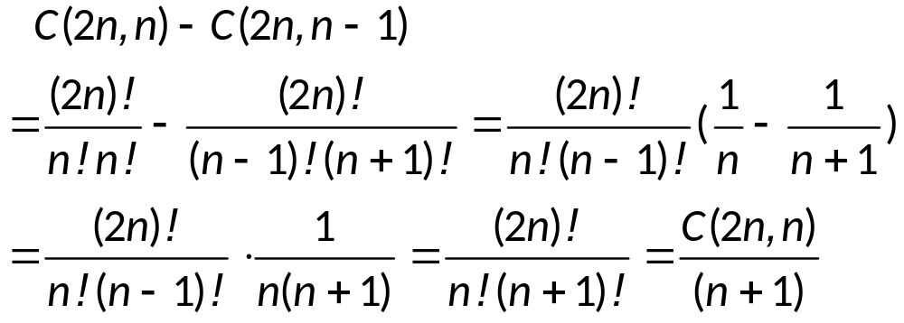
Catalan Numbers
  Solution.
  由上例知， (n+1)×(n-1) 网格的走法有 C(2n,n-1)种，故本例的正确走法有：

Slide 29
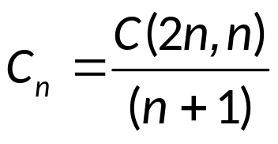
Catalan Numbers
Definition. (Catalan 数)
  The counting
  is called the Catalan number. (Charles Catalan,1814-1894）
  C₀ = 1, C₁ = 1, C₂ = 2, C₃ = 5, C₄ = 14, C₅ = 42, …
  C_{n} is also the number of ways to parenthesize the product of n+1 numbers, x₀, x₁, x₂, …, x_{n}, to specify the order of multiplication

Slide 30
Catalan Numbers
Remark.
  C_{n} is also the number of ways to parenthesize the product of n+1 numbers, x₀, x₁, x₂, …, x_{n}, to specify the order of multiplication
Example.
  C₃ = 5 because there are 5 ways to parenthesize x₀, x₁, x₂, and x₃ to determine the order of multiplication:
    ( ( x₀ ⋅ x₁ ) ⋅ x₂ ) ⋅ x₃
    ( x₀ ⋅ ( x₁ ⋅ x₂ ) ) ⋅ x₃
    ( x₀ ⋅ x₁ ) ⋅ ( x₂ ⋅ x₃ )
    x₀ ⋅ ( ( x₁ ⋅ x₂ ) ⋅ x₃ )
    x₀ ⋅ ( x₁ ⋅ ( x₂ ⋅ x₃ ) )

Slide 31
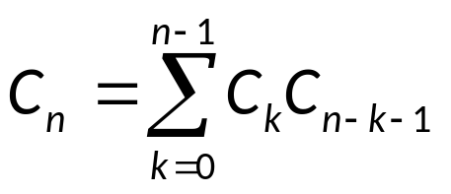
Catalan Numbers
The recurrence relation for C_{n}
  The base cases here are:
  C₀ = 1
  C₁ = 1
  and the recurrence relation for C_{n} is:
  C_{n} = C₀C_{n-1} + C₁C_{n-2} + … C_{n-2}C₁ + C_{n-1}C₀
  which is:

Slide 32
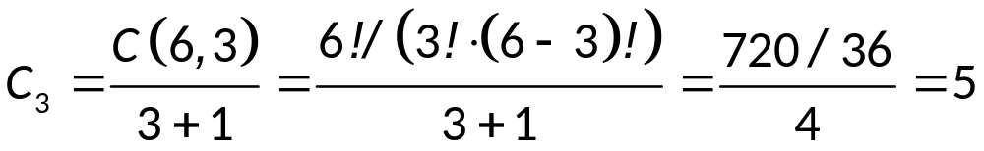
Catalan Numbers
Example.
  How many ways are there to parenthesize an expression with 4 terms?
  Solution.
  It can be shown that:
  C₃ represents the catalan number with 4 terms, n₀ through n₃. So

Slide 33
Catalan Numbers
Remark.
  The recurrence relation for C_{n} is:
  C_{n} = C₀C_{n-1} + C₁C_{n-2} + … C_{n-2}C₁ + C_{n-1}C₀
  which is:
  And the expression
  represents a solution to the recurrence relation. The solution allows us to provide a value for any term in the sequence without reference to any previous term.

Slide 34
Catalan Numbers
Remark.
  Recall that:
    A recurrence relation for the sequence {a_{n}} is an equation that expresses a_{n} in terms of one or more of the previous terms of the sequence, namely, a₀, a₁,…,a_{n-1}, for all integers n with n ≥ n₀, where n₀ is a nonnegative integer.
    A sequence is called a solution of a recurrence relation if its terms satisfy the recurrence relation.

Slide 35
Assignment
Exercises after 7.1: No.4 , 44. (Ver.6)

